Slide 1
2 A
A WRITER´S ROOM

Slide 2
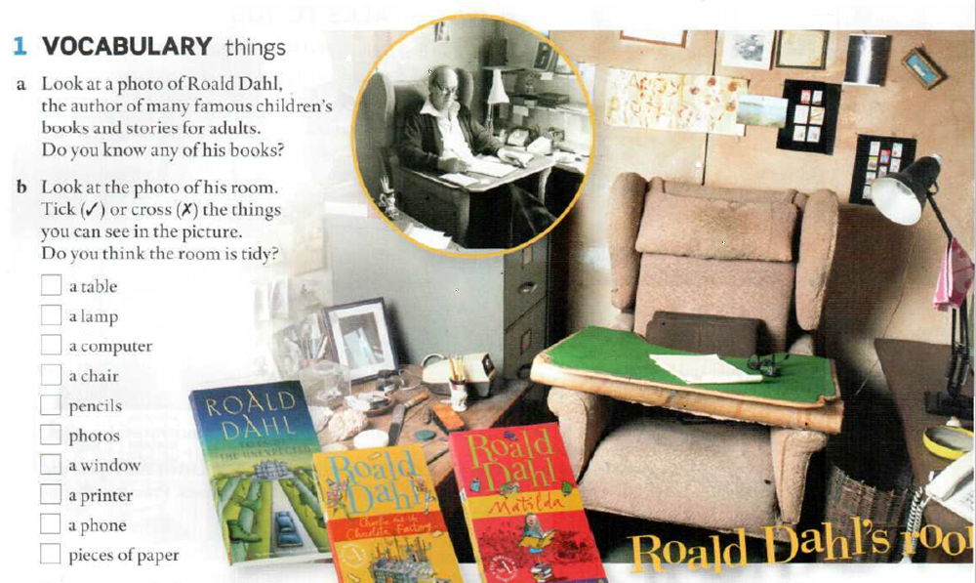


Slide 3
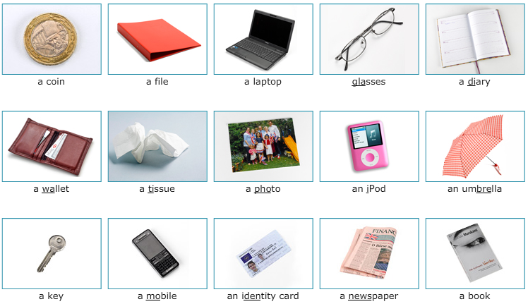
THINGS

Slide 4
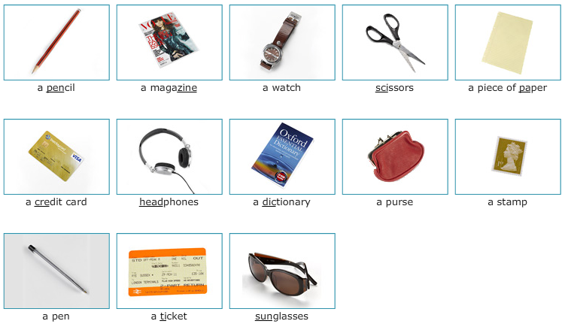
THINGS

Slide 5
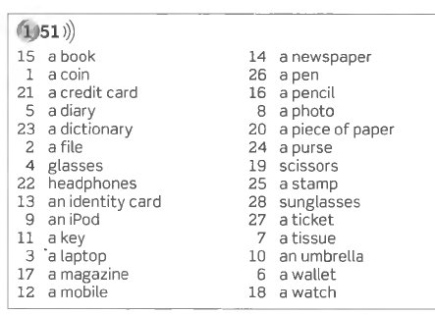
THINGS
(PAGE 151)
a/an
---
Listen, repeat, memorize and say.

Slide 6
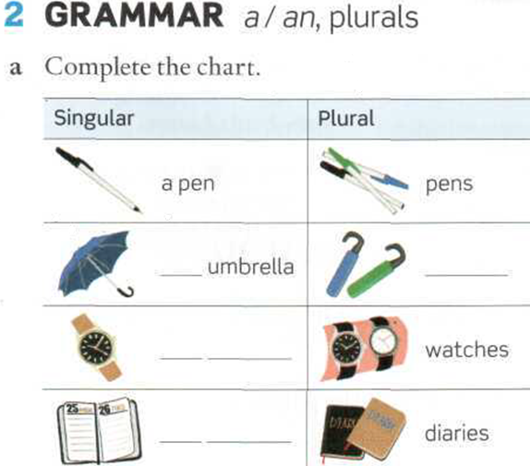
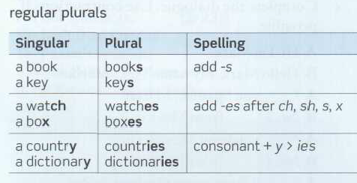
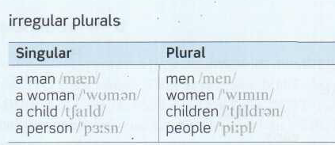
Page 126
Page 12
an
umbrellas
a watch
a diary

Slide 7
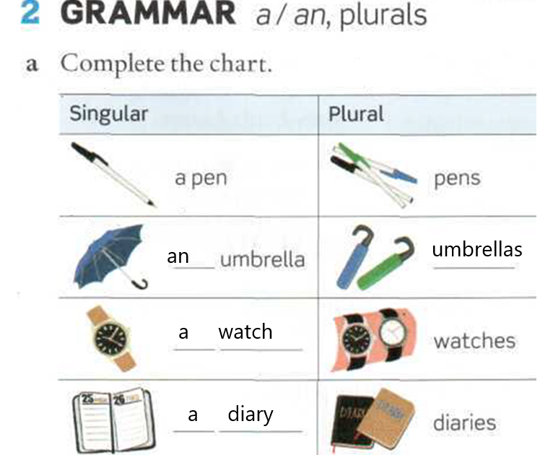
PLURALS

Slide 8
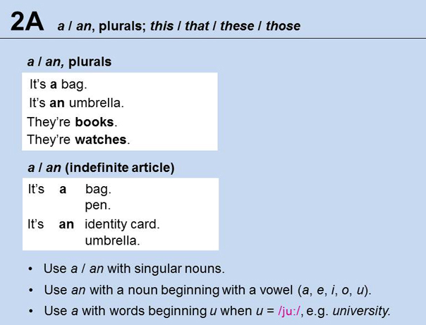

Slide 9
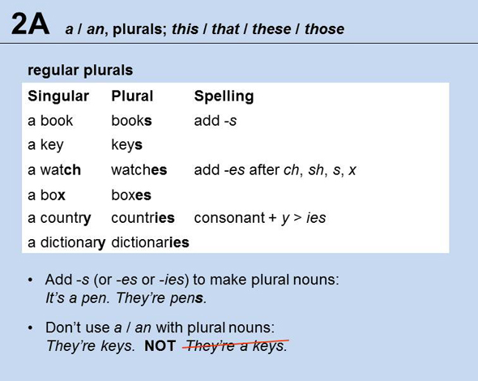

Slide 10
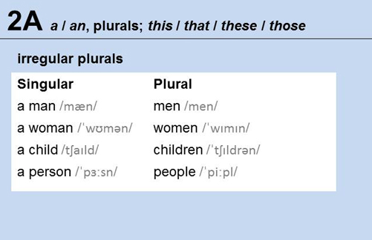

Slide 11
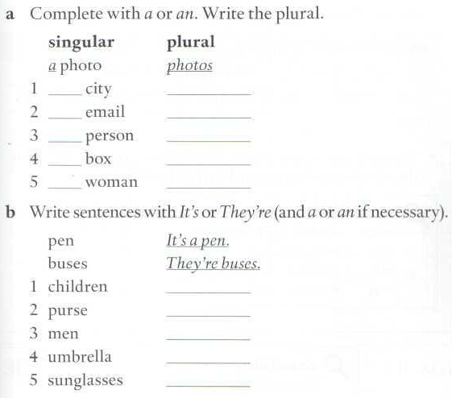
a
cities
an
emails
a
people
a
boxes
a
women
They’re children.
It’s a purse.
They’re men.
It’s an umbrella.
They ‘re sunglasses.

Slide 12
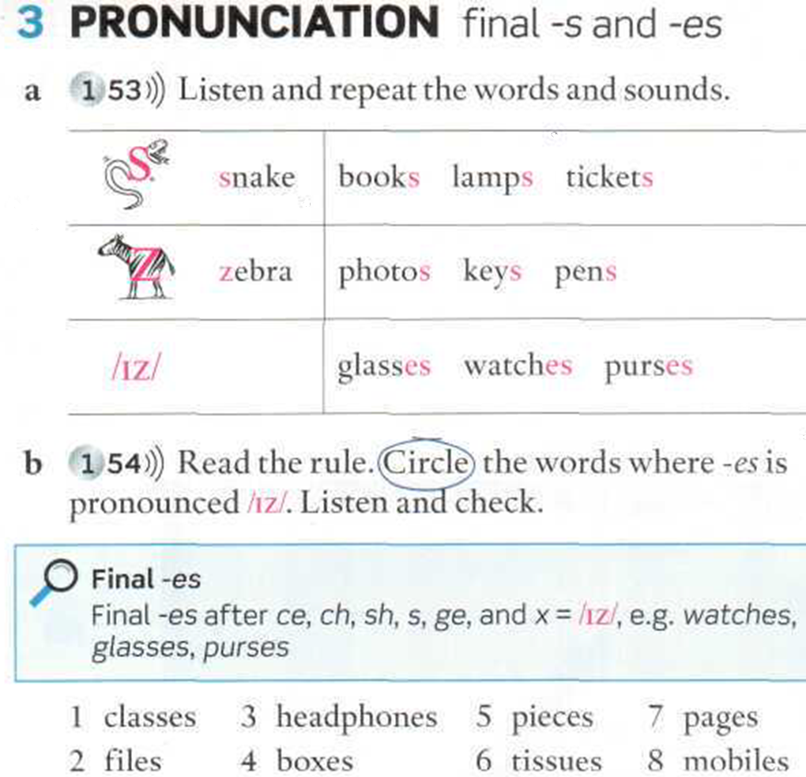
Page 12
1 classes 4 boxes 5 pieces 7 pages

Slide 13
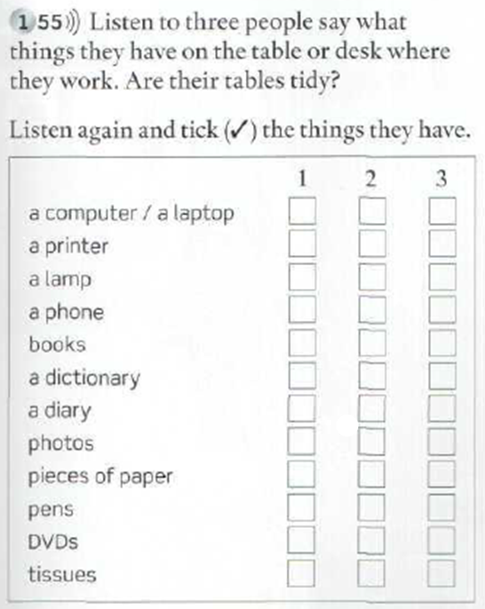

What´s on the table? Is the table tidy?)
Answer these questions:
What do you have on your table or desk?
Is your table tidy, very tidy, not very tidy or untidy?

Slide 14
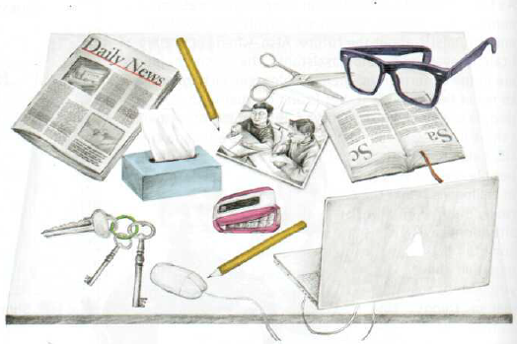
Look at the picture. Try to memorize the things on the table. Then close the presentation and write down the ten things on the table
10 THINGS ON MY TABLE

Slide 15
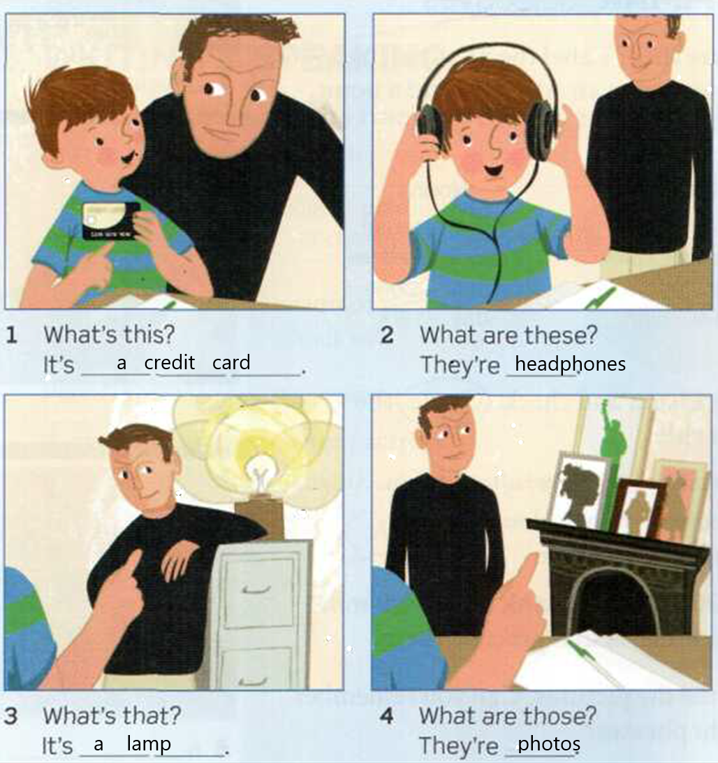
this/that/ these/those (page 13)
Page 12

Slide 16
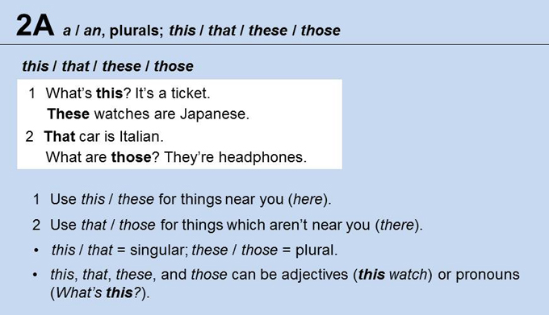
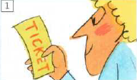
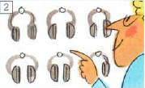

Slide 17
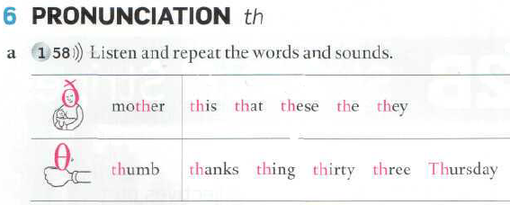
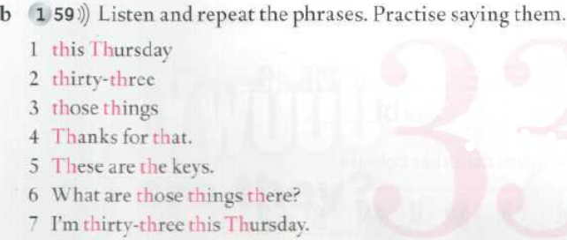
Oral assignment

Slide 18
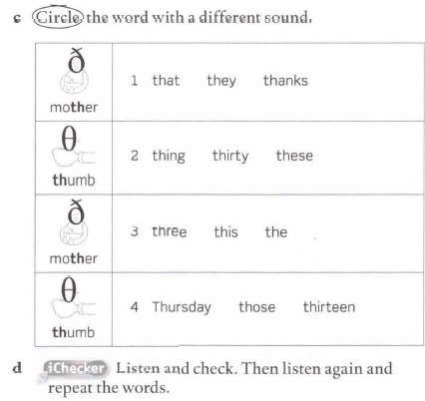
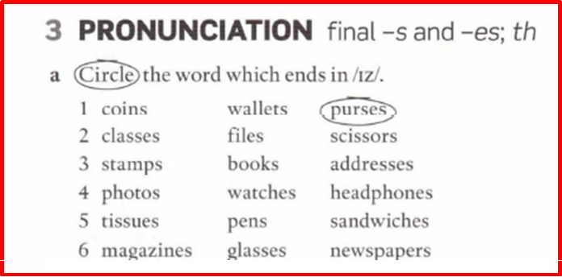
PRONUNCIATION

Slide 19
5 LISTENING
Listen to four people talking about things they have in their bags. Which person ... ?
1 has a book in his I her bag which helps him I her speak to people
2 has something to listen to music
3 changes bags every day
4 has a computer in his I her bag
3
2
4
1

